Slide 1
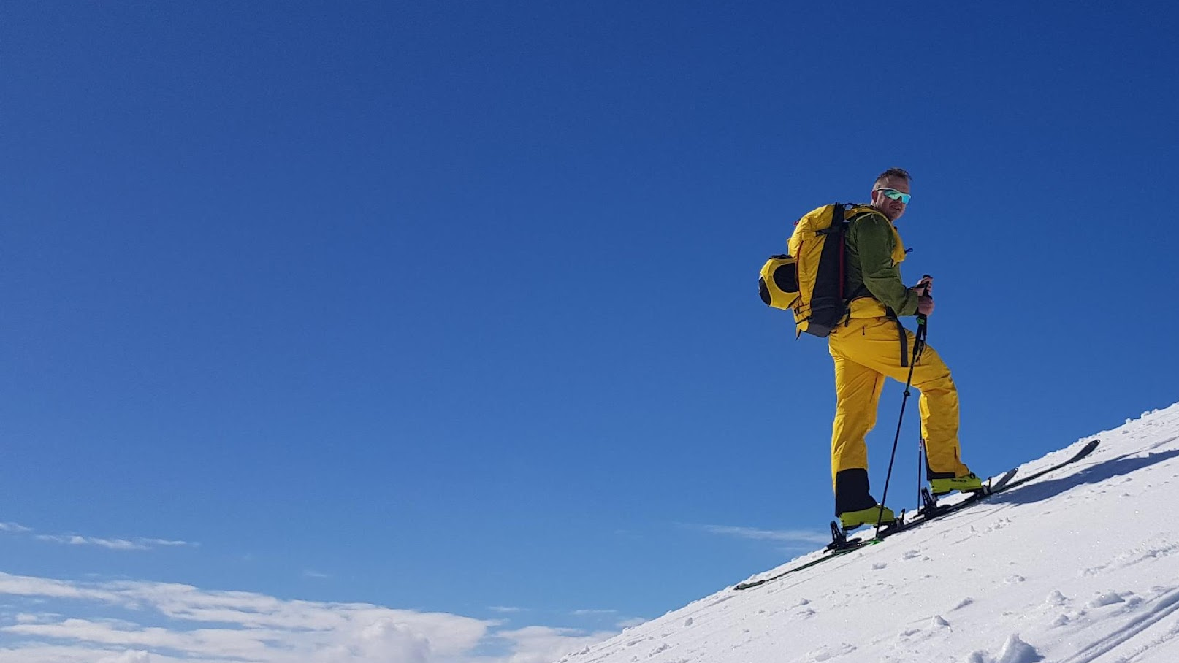
Ski Resort
Analysis
Ryan Loughran, Brian (Joo Hyoung) Park,
Oliver (Chung-Yeh) Yang, Yao Wang

Slide 2
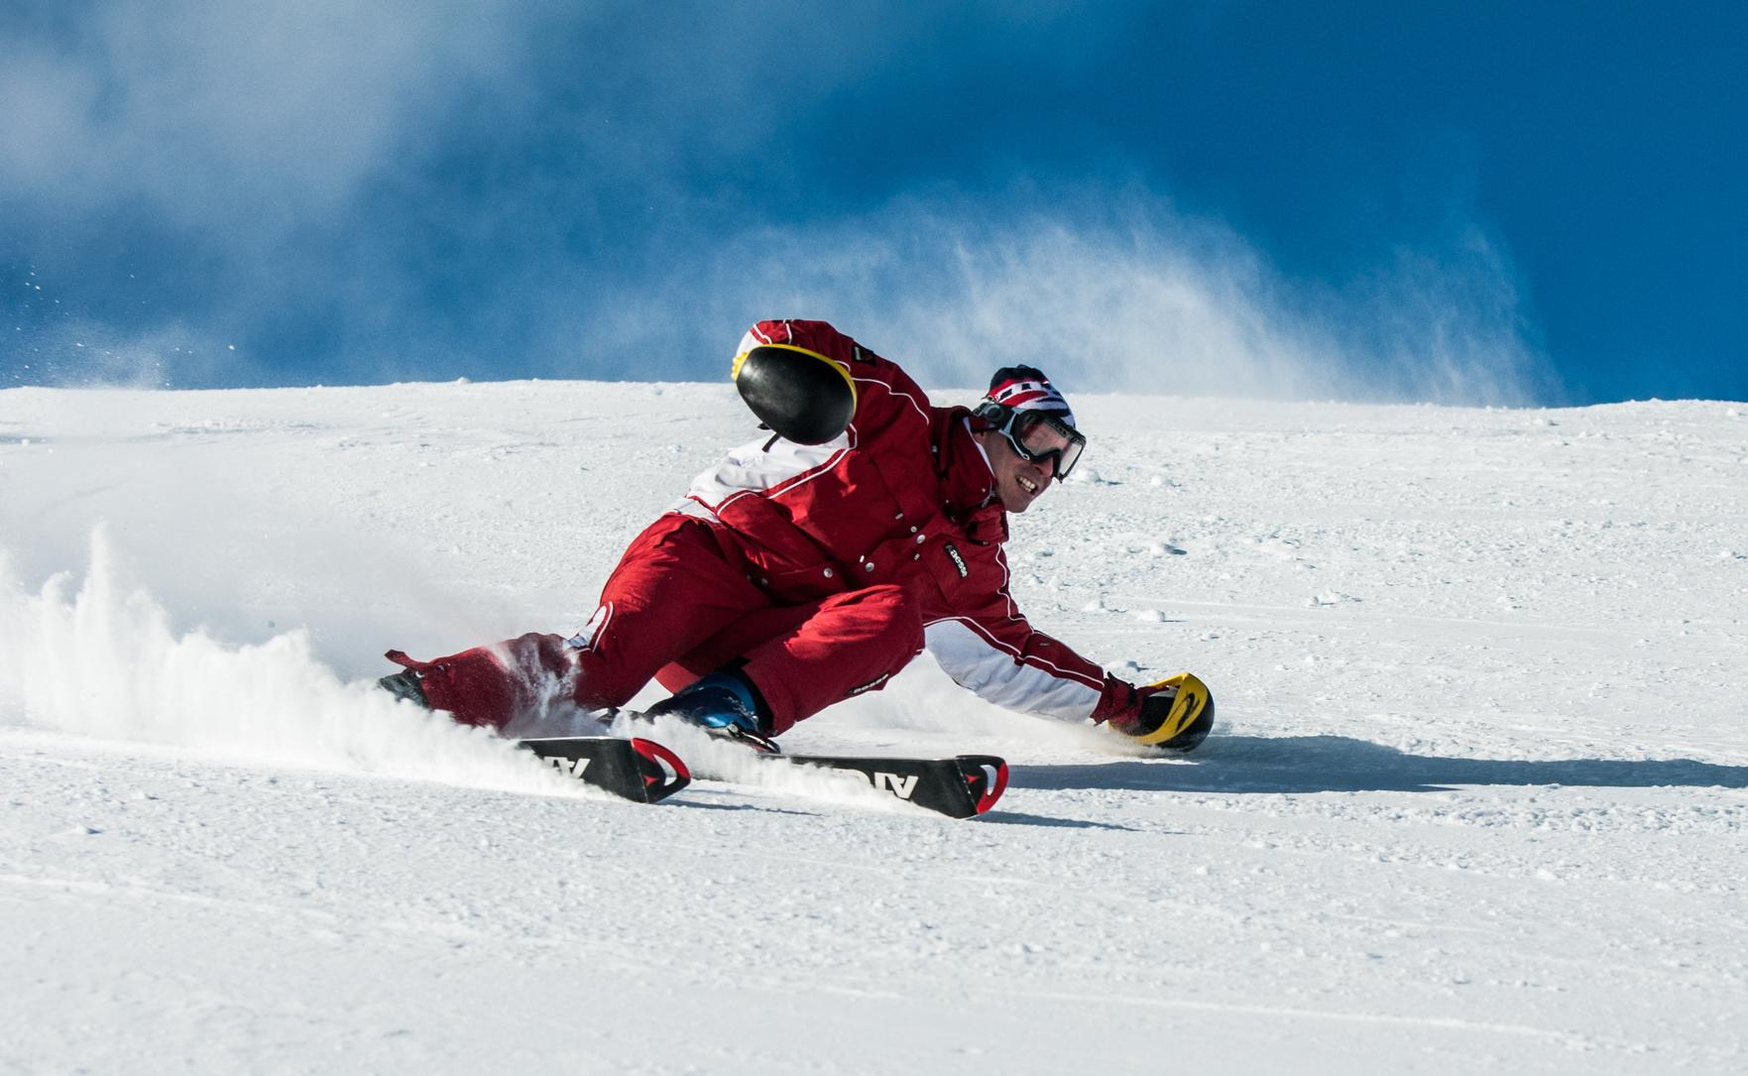
Table of Contents
Problem we are trying to solve/ target
Data Description
Data Visualization
Methods to predict
Comparison of models
Challenge/Conclusion

Slide 3

・Topic Introduction・
・Data Cleaning Process・
・Data Findings & Visualizations・
・Modeling・
・Evaluation・
・Challenges ・
Objective: Predict the price of a lift ticket based on ski resort features
Target Audience:
Skiers looking to maximize their skiing experience by purchasing a fairly priced lift ticket based on mountain features
Ski Resorts looking at what a reasonable price for a ticket would be based on the resorts features
Challenges: Model does not take into account intangible value driving factors such as reputation
Why are we interested in predicting ski resort ticket price?
The prices for day passes have skyrocketed and are as high as $200 at some resorts.
Prices are rising faster than inflation
Customers want to try and maximize the value of their purchase by making sure they aren’t being overcharged.
https://snowbrains.com/inflation-and-the-rising-cost-of-skiing-explained/
Notes:
Who cares about the problem/why

Slide 4
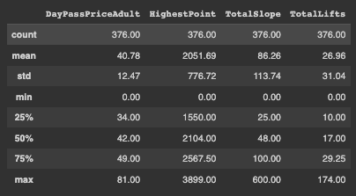
・Topic Introduction・
・Data Findings & Visualizations・
・Data Cleaning Process・
・Modeling・
・Evaluation・
・Challenges ・
Data Description
Source: Ski-resort-stats.com
16 columns with 376 rows
Numerical Variables: Highest point, Lowest point, Beginner slope, Intermediate slope, Difficult slope, Total slope, the amount of surface lifts, the amount of chairlifts, the amount of gondola lifts, Total number of lifts, Lift capacity, Amount of snow cannon
Categorical Variables: Location, Snow park availability, Night Ski availability
Notes:
Oliver

Slide 5
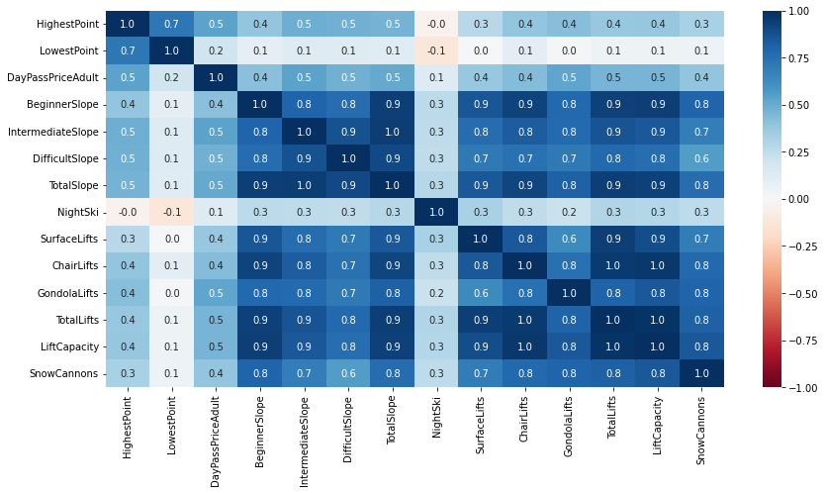
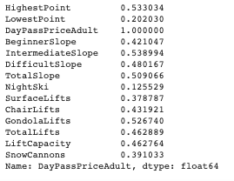
・Topic Introduction・
・Data Findings & Visualizations・
・Data Cleaning Process・
・Modeling・
・Evaluation・
・Challenges ・
Correlation Table

Slide 6
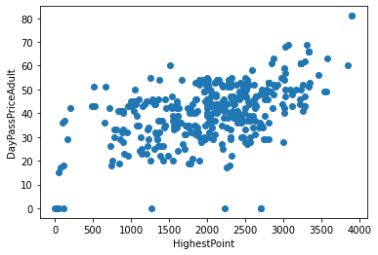
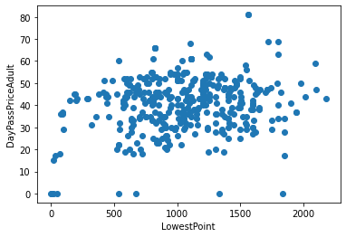
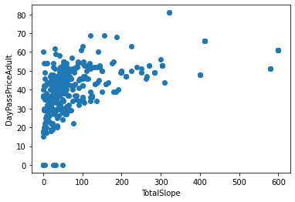
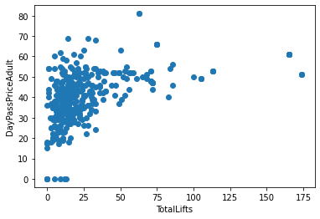
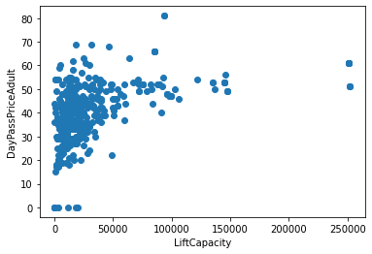
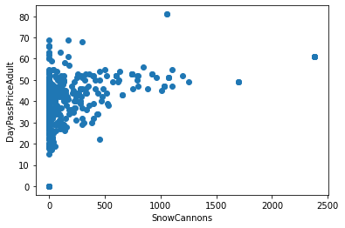
・Topic Introduction・
・Data Findings & Visualizations・
・Data Cleaning Process・
・Modeling・
・Evaluation・
・Challenges ・
Numerical Variables
Highest Point
Lowest Point
Total Slope
Total Lifts
Lift Capacity
Snow Cannons

Slide 7
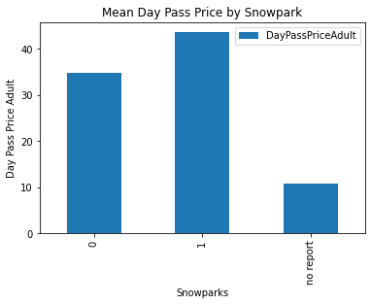
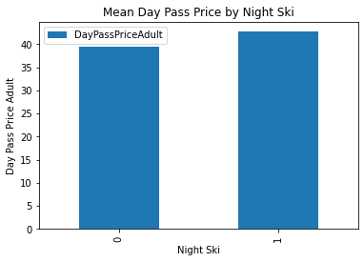
・Topic Introduction・
・Data Findings & Visualizations・
・Data Cleaning Process・
・Modeling・
・Evaluation・
・Challenges ・
Categorical Variables

Slide 8
・Topic Introduction・
・Data Findings & Visualizations・
・Data Cleaning Process・
・Modeling・
・Evaluation・
・Challenges ・
Data Cleaning Process
Step 1:
Is there any null values?
df.isnull().values.any()
Step 3:
Categorical -> Dummy variables:
df = df.replace({'Yes': 1 , 'No': 0})
df = df.drop(df[df.eq('no report').any(1)])
Step 2:
Drop unnecessary variables:
df = df.drop(["Country","Unnamed: 0"],axis = 1)
Step 4:
Feature engineering
df["Total Length"] = df["HighestPoint"] - df["LowestPoint"]

Slide 9
・Topic Introduction・
・Data Findings & Visualizations・
・Data Cleaning Process・
・Modeling・
・Evaluation・
・Challenges ・
Select Variables
Numerical
Highest_Point - Lowest_Point -> Total Length
Beginner Slope
Intermediate Slope
Difficult Slope
Total Slope
Surface Lifts
ChairLifts
Gondola Lifts
Total Lifts
Lift Capacity
Snow Cannons
Categorical
NightSki
SnowPark
13 variables in total

Slide 10
・Topic Introduction・
・Data Cleaning Process・
・Data Findings & Visualizations・
・Modeling・
・Evaluation・
・Challenges ・
Linear Regression
Intercept:
41.0374
Coefficient:
Beginner Slope: -16.8448
Intermediate Slope: -9.3926
Difficult Slope: -5.9423
Total Slope: 32.0339
Snow parks: 2.5527
Night Ski: -0.2186
Surface Lifts: -0.0056
Chair Lifts: 1.7727
Gondola Lifts: 3.9494
Total Lifts: 1.5441
Lift Capacity: -3.8577
Snow Cannons: -1.067
Total Length: 3.3123
 | Root Mean Squared Error
Training data(y_train) | 9.6488
Cross Validation(k=5) | 10.0392
Cross Validation(k=10) | 9.9433
Testing data(y_test) | 8.8156

Slide 11
・Topic Introduction・
・Data Cleaning Process・
・Data Findings & Visualizations・
・Modeling・
・Evaluation・
・Challenges ・
Ridge & Lasso Regression
Implement RidgeCV and LassoCV to find the best RMSE
RMSE when k = 5 | Ridge | Lasso
Training | 8.8957 | 8.9072
Testing | 7.6714 | 7.6707
The RMSE of ridge and lasso are similar
Notes:
Oliver

Slide 12
・Topic Introduction・
・Data Cleaning Process・
・Data Findings & Visualizations・
・Modeling・
・Evaluation・
・Challenges ・
Ridge & Lasso Regression
Ridge(λ=10.0):
Intercept: 41.0374
Beginner Slope: -1.749
Intermediate Slope: 3.2011
Difficult Slope: -0.0124
Total Slope: 0.5999
Snowparks: 2.345
NightSki: -0.5438
Surface Lifts: -0.5374
ChairLifts: 0.1237
Gondola Lifts: 2.5718
Total Lifts: 0.3144
Lift Capacity: -0.108
Snow Cannons: -0.3794
Total Length: 3.1755
Lasso(λ=0.0654):
Intercept: 41.0374
Beginner Slope: -1.3343
Intermediate Slope: 3.3476
Difficult Slope: 0.0
Total Slope: 0.0
Snow parks: 2.2272
Night Ski: -0.4323
Surface Lifts: -0.1739
Chair Lifts: -0.0
Gondola Lifts: 2.3246
Total Lifts: -0.0
Lift Capacity: -0.0
Snow Cannons: -0.0951
Total Length: 3.299

Slide 13
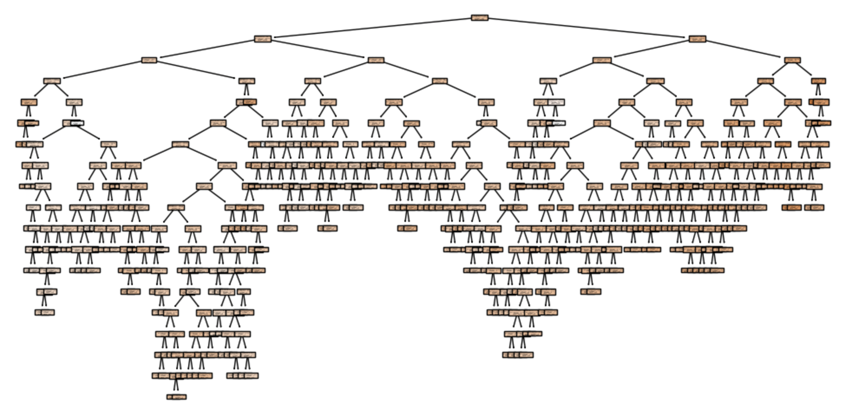
・Topic Introduction・
・Data Cleaning Process・
・Data Findings & Visualizations・
・Modeling・
・Evaluation・
・Challenges ・
The Decision Tree - Full Tree
Number of classes: [1]
Number of features: 14
Number of nodes: 555
Number of leaves: 278
Number of maximum depth: 18
RMSE: 11.26
Notes:
Yao

Slide 14
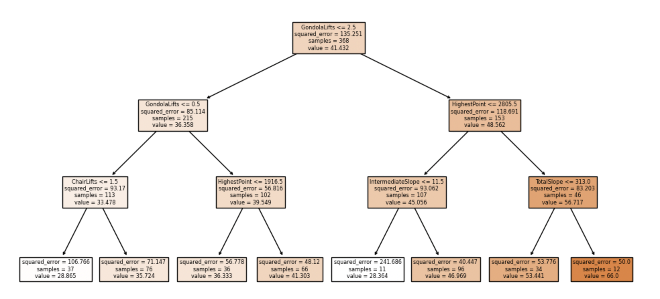
・Topic Introduction・
・Data Cleaning Process・
・Data Findings & Visualizations・
・Modeling・
・Evaluation・
・Challenges ・
The Decision Tree - Pruned Tree
Number of classes: [1]
Number of features: 14
Number of nodes: 15
Number of leaves: 8
Number of maximum depth: 3
RMSE: 9.56
Notes:
Yao

Slide 15
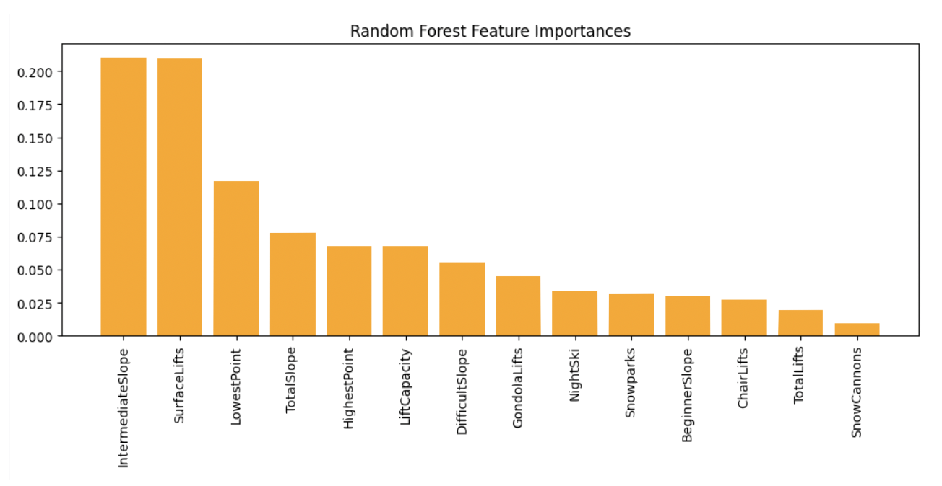
・Topic Introduction・
・Data Cleaning Process・
・Data Findings & Visualizations・
・Modeling・
・Evaluation・
・Challenges ・
Random Forest
GridSearchCV
CV = 5
Min. Samples Split : 5
n_estimators:
50
RMSE = 9.27

Slide 16
・Topic Introduction・
・Data Cleaning Process・
・Data Findings & Visualizations・
・Modeling・
・Evaluation・
・Challenges ・
Boosting
Hyperparameter | Value
Tree Depth | 5
Learning Rate | .098
Number of Trees | 225
RMSE | 8.58
RMSE varies from low 8 to high 10
Small data set could lead to high variation
Improved RMSE as compared to other methods excluding Ridge and Lasso

Slide 17
・Topic Introduction・
・Data Cleaning Process・
・Data Findings & Visualizations・
・Modeling・
・Evaluation・
・Challenges ・
Comparison with different models
Method | Best RMSE
Naïve Baseline | 12.46
Linear Regression | 8.82
Lasso Regression | 7.67
Ridge Regression | 7.67
Decision Tree - Full Tree | 11.26
Pruned Tree | 9.56
Random Forest | 9.27
Boosting | 8.58

Slide 18
・Topic Introduction・
・Data Cleaning Process・
・Data Findings & Visualizations・
・Modeling・
・Evaluation・
・Challenges ・
Challenges
The dataset is too small
The dataset is limited to Europe
Other possible factors not mentioned :
Living standards of different countries
Accessibility of the resorts
Opening season of the resorts

Slide 19
Takeaways
Lasso and Ridge Regression gives us the smallest RMSE
The number of slopes and surface lifts are most influential for ticket price
Customers can predict the ticket price based on the features information provided to determine whether it is overpriced or not
Resort can improve their features or adjust ticket price to raise their competitiveness

Slide 20
Thank You!
Do you have any questions?

